Slide 1
Maxwell’s Equations
Faraday demonstrated that a magnetic field produces a measurable effect on a beam of light. This prompted him to speculate that light involves oscillation of electric and magnetic field lines, but his limited mathematical ability prevent him from pursuing this idea.
Maxwell, a young admirer of Faraday, believed that the closeness of these two numbers, speed of light and the inverse square root of ε₀ and μ₀, was more than just coincidence and decide to develop Faraday’s hypothesis.
In 1865, he predicted the existence of electromagnetic waves that propagate at the speed of light.

Slide 2
Maxwell’s Equations
.
With the inclusion of Maxwell’s contribution, we now display all the fundamental equations in electromagnetism. There are just four:
Gauss
∫ E ⋅ dA = ^{Q}
ε ₀
∫ B ⋅ dA = 0
Gauss
Faraday
∫ E ⋅ dl = − ^{dΦ B}
dt
∫
dΦ _{E )}
Ampere - Maxwell
B ⋅ dl = μ (I + ε
0
0
dt

Slide 3
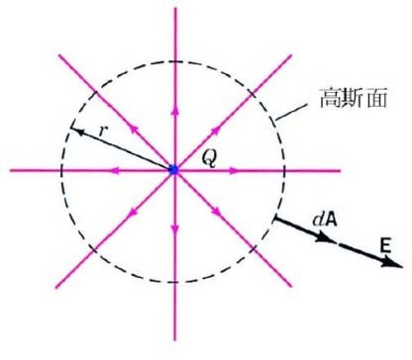
Gauss’s Law
.
How much is the flux for a spherical Gaussian surface around a point charge?
The total flux through this closed Gaussian surface is
∫
Φ = E ⋅ nˆda = ^{kQ} ⋅ 4π r ²
E
_{r} 2
= 4πKQ = ^{Q}
ε ₀
The net flux through a closed surface equals 1/ε₀ times the net charge enclosed by the surface.
Can we prove the above statement for arbitrary closed shape?
6

Slide 4
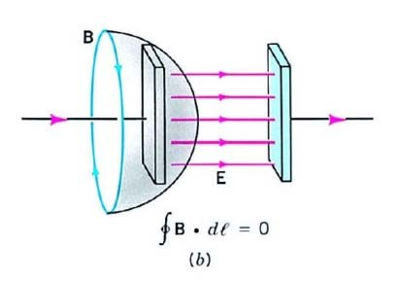
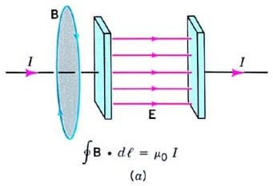
Displacement Current
The inadequacy of the Ampere’s law does not give consistent answers for the following two choices.
Maxwell proposed that a new type of current, which he called displacement current, I_{D}, can be associated with the nonconductor between the plates. Thus Ampere’s law should
be written as
∫ B ⋅ dl = μ₀ (I + I_{D} )

Slide 5
Where does the displacement current come from? The change of the electric flux with time.
Consider a parallel plate capacitor
Q = ε₀ AE = ε₀Φ _{E}
dQ _{= ε} dΦ _{E}
= I
0
D
dt dt
With Maxwell’s modification, Ampere’s law becomes
∫
dΦ _{E )}
B ⋅ dl = μ (I + ε
0
0
dt

Slide 6
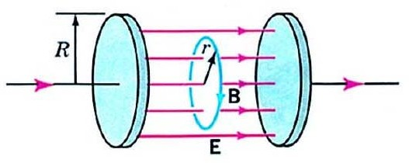
Use the Ampere-Maxwell law to find the magnetic field between the circular plates of a parallel-plate capacitor that is charging. The radius of the plates is R. Ignore the fringing field.
Solution:
∫ B ⋅ dl = B(2πr)
Φ _{E} = E(πr )
2
dE
B(2πr) = μ ε (πr )
2
dt
B = ¹ μ ε r ^{dE} (r < R)
0 0
0 0
2 dt
4

Slide 7
Faraday’s Law
The emf is always opposite to the sign of the change in flux ΔΦ.
This feature can be incorporated into Faraday’s law by including a negative sign.
The modern statement of Faraday’s law of electromagnetic induction is
₌ ₋ dΦ
V
EMF
dt
Suppose that the loop is replaced by a coil with N turn. The net emf induced in a coil with N turns is
V = − N ^{dΦ}
EMF
dt
10

Slide 8
Derivation of the Wave Equation
Mathematical manipulation of Faraday’s law and Ampere- Maxwell law leads directly to a wave equation for the electric and magnetic field.
Faraday’s law | Ampere-Maxwell law
∫ E ⋅ dl = − ^{dΦ B} dt | ∫ B ⋅ dl = μ (I + ε ^{dΦ E} ) 0 0 _{dt}
∇× E = − ^{∂B} ∂t | ∇× B = μ ε ^{∂E} 0 0 _{∂t}
∂(∇× B)
⇒ ∇ E = μ ε
∂²E
∇× (∇× E) = −
2
0 0
∂t
∂t
2
13

Slide 9
Electromagnetic Waves
In Chapter 16, we saw that a wave traveling along the x axis with a wave speed v satisfies the wave equation:
∂² y ₌ 1 ∂² y
_{v}2
∂x² ∂t ²
From Faraday’s law and Ampere-Maxell law, we can derive the following equations:
∂² B ∂² B
∂² E ∂² E
= μ ε
z ,
y
= μ ε
y
z
∂x² ∂t ² ∂x² ∂t ²
0 0 0 0
On comparing these with standard wave equation, we see that the wave speed is
1
(μ = 4π ×10 H/m and ε = 8.55×10⁻¹² F/m)
c =
−7
μ ε
0 0
0 0
= 3.00 ×10⁸ m/s (speed of light in vacuum)

